Slide 1
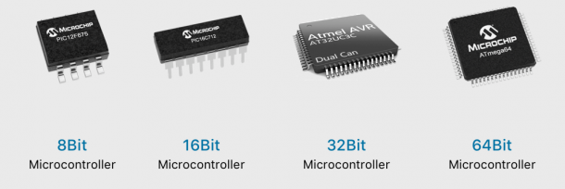
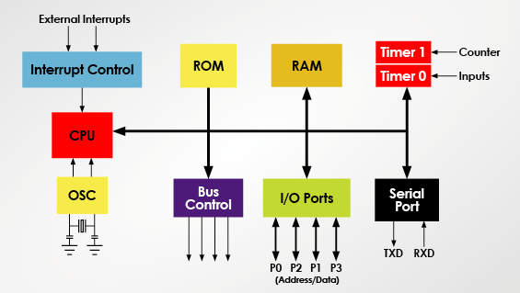
Microprocessor – Microcontroller Introduction
LÊ TRỌNG NHÂN
trongnhanle@hcmut.edu.vn
trongnhanle85@gmail.com

Slide 2
Course Information
15 weeks for Lectures
6 weeks for Labs (30%)
24h project for Mid-term (20%)
MCQs and Essay for Final-term (40%)
Final project (10%) and Plus (maximum 2)

Slide 3

15 Weeks for Lectures
Understand microcontroller basics including all common interfaces:
General Input/Output GPIO (LEDs, Buttons)
Interrupts: Timer Interrupt
Serial communications: UART, I2C, SPI
Final projects:
Validate on hardware platforms
Group of 3 students
Presentations and Demos
Zalo group:
https://zalo.me/g/ismims248

Slide 4
6 Weeks for Labs
Software requirements:
STMCubeIDE
Proteus simulations
Github
Reports are required to submit

Slide 5
24h Project for Midterm
A project is given and students have 24 hour to submit
The format is similar to the LAB:
Project description
Project manual
5 – 10 steps to finalize the project
Topic is related to LED – Buttons – Timer Interrupt
Programing on STM32CubeIDE
Simulate on Proteus
Submit the Report for evaluation

Slide 6
Microcontroller and Microprocessor Applications
Networking & communications
phones, modems, switches, routers, signal processors
Embedded products & systems
consumer electronics, appliances, entertainment devices, medical devices, security, transportation
Scientific instruments & equipment
simulation, testing, sensing, logging, reporting, analyzing
Many more.

Slide 7
Microprocessor vs Microcontroller
MPU | MCU
Stand-alone CPU, RAM, ROM and IO (and Timer) are separated | CPU, RAM, ROM and IO (and Timer) are all on a single chip
ROM, RAM and IO can be customized | ROM, RAM and IO are fixed
Expensive, versatility and general purpose | Low cost, power and single-purpose (control-oriented)
High resource of power, processing and memory (for AI inferences) | Low resource of power, processing and memory (for device controller)
Normal Operating System (32 or 64 bits) | Real Time Operating System (8 or 16 bit)

Slide 8
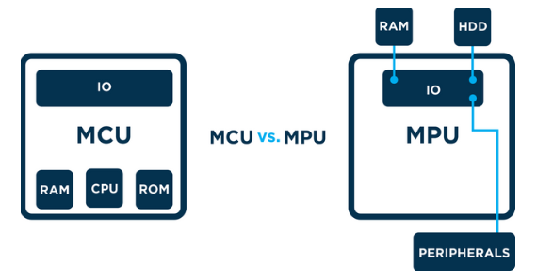
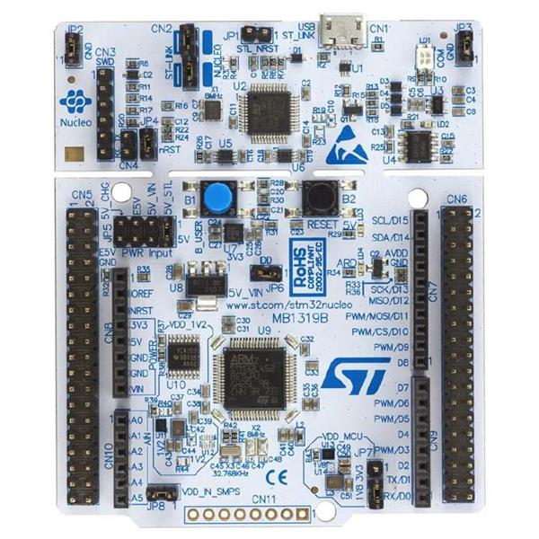

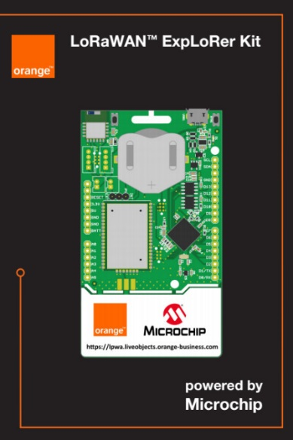
Micro-Controller Platform
Micro-Controller Unit (MCU) contains RAM, ROM and IO
Micro-Processor Unit (MPU) only contains the CPU
System on Chip (SoC) refers to MCUs with a greater number of onboard peripherals and functionality
http://www.ti.com
http://www.microchip.com

Slide 9
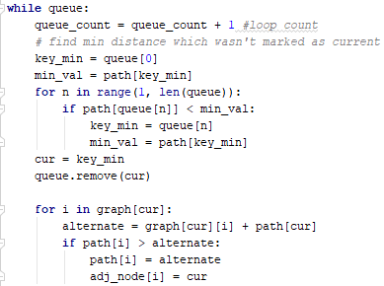
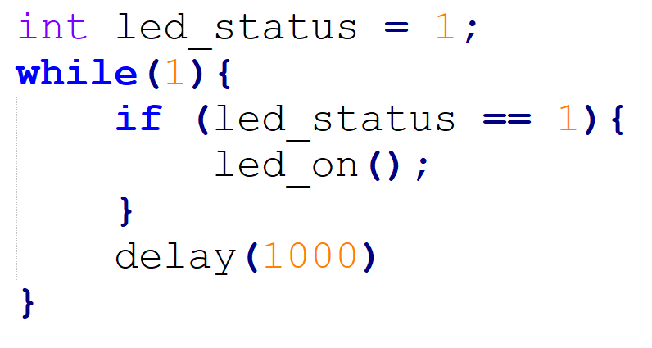
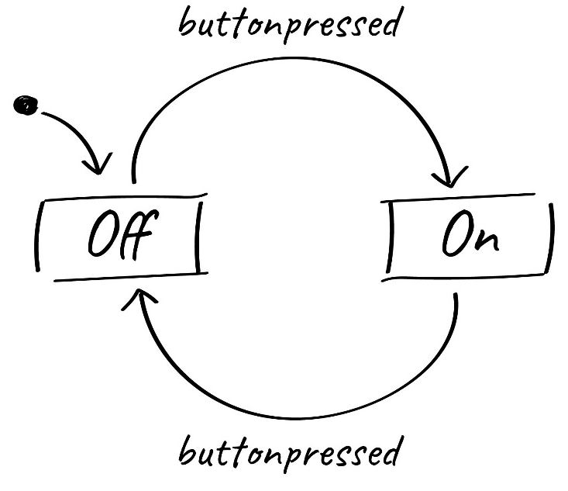
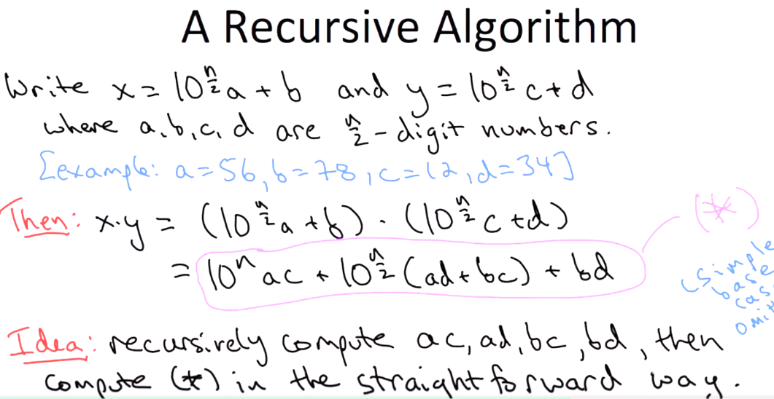
Program on MPU vs MCU

Slide 10

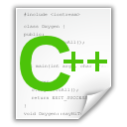
C Language: Header and C++ Files
#include “led.h”
int T_on;
int T_off;
int counter;
void setOn(long duration){
//TODO: set LED on here
}
void setoff(long duration){
//TODO: set LED off here
}
void delay(long duration){
//TODO: set delay here
}
#ifndef __LED_H_
#define __LED_H_
#include <system_lib.h>
#include “user_lib.h”
#include “UserFolder/lib.h”
extern int T_on;
extern int T_off;
void setOn(long duration);
void setoff(long duration);
#endif

Slide 11
C Language: Main File
#include “led.h”
#include “timer.h”
#include “gpio.h”
#include “button.h”
void main(){
initGPIO();
initTimer();
initButton();
initLED();
….
….
while(1){};
}
void timer_isr(){
}
void ext_isr(){
}
Modules/ Libraries are included
LED
Modules/ Libraries are initiated
TIMER
GPIO
System operations are implemented in interrupt functions
BUTTON

Slide 12
Warm up Exercises
LED turns on and off every second (LED Blinky)
LED turns on for 3 seconds and then turns off for 5 seconds.
Digital Clock with hour, minute and second
Change the delay from 1000 to 10

Slide 13
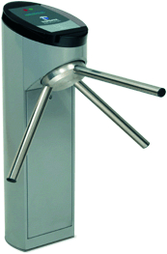
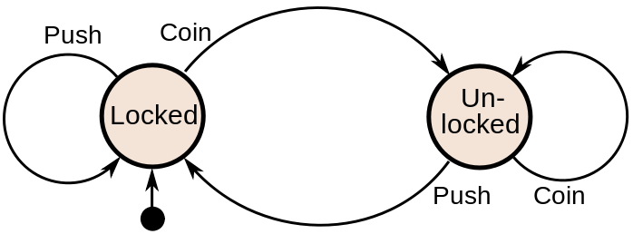
Finite State Machine (FSM)
Finite-State Machine (FSM) or Deterministic Finite Automata (DFA), finite automaton, or simply a state machine, is a mathematical model of computation
Current State | Input | Next State
Locked | Coin | Unlocked
 | Push | Locked
Unlocked | Coin | Unlocked
 | Push | Locked
A turnstile

Slide 14
Finite State Machine Programming
while(1){
switch(status){
case LOCKED: lock_turnstile(); //operation in a state
if(Coin == true) //transition condition
status = UNLOCKED; //next state
break;
case UNLOCKED:
unlock_turnstile(); //operation in a state
if(Push == true) //transition condition
status = LOCKED; //next state
break;
default:
break;
}
}

Slide 15
Example
Given an LED turns on for T_on and then turns off for T_off.
Design an DFA for this LED
Implement the DFA in Arduino
digitalWrite(13, HIGH): turn on the LED
digitalWrite(13, LOW): turn off the LED
setTime(duration): set a clock (timer_flag = 0), when the clock is expired, timer_flag = 1; duration is in mili-seconds.

Slide 16
Answer
timer_flag == 1
INIT
LED_ON
LED_OFF
timer_flag == 1
INIT: Set pin 13 to OUTPUT mode, set timer
LED_ON: Turn on the LED
LED_OFF: Turn off the LED

Slide 17
Answer (Arduino Code)
void loop(){
switch(status){
case INIT: pinMode(13, OUTPUT);
setTimer(T_on);
status = LED_ON;
digitalWrite(13, HIGH);
break;
case LED_ON:
if(timer_flag == 1){
status = LED_OFF;
setTimer(T_off);
digitalWrite(13, LOW);
}
break;
case LED_OFF:
if(timer_flag == 1){
status = LED_ON;
setTimer(T_on);
digitalWrite(13, HIGH);
}
break;
default:
break;
}
delay(10);
}
void timer_run(){
if(timer_counter > 0)
timer_counter--;
if(counter_timer == 0)
timer_flag =1;
}
void setTimer(long duration){
timer_counter = duration;
timer_flag = 0;
}

